Slide 1
Nyc PAYROLL spending
Jatin Chittoor, jenny yi, Stephanie roman, roaya helal

Slide 2
Presentation requirements
8-10 minutes long
Describe the core message or hypothesis for your project
Describe the questions you and your group found interesting, and what motivated you to answer them
Summarize where and how you found the data you used to answer these questions
Describe the data exploration and cleanup process (accompanied by your Jupyter Notebook)
Describe the analysis process (accompanied by your Jupyter Notebook)
Summarize your conclusions. This should include a numerical summary (i.e., what data did your analysis yield), as well as visualizations of that summary (plots of the final analysis data)
Discuss the implications of your findings. This is where you get to have an open-ended discussion about what your findings "mean".
Tell a good story! Storytelling through data analysis is no different than in literature. Find your narrative and use your analysis and visualization skills to highlight conflict and resolution in your data.

Slide 3
Presentation guidelines
Title slide, must include name of project & group members
Motivation & Summary Slide
Define the core message or hypothesis of your project.
Describe the questions you asked, and why you asked them
Describe whether you were able to answer these questions to your satisfaction, and briefly summarize your findings
Questions & Data – elaborate on the questions you asked, describing what kinds of data you needed to answer them and where you found it
Data Cleanup & Exploration
Describe the exploration and cleanup process
Discuss insights you had while exploring the data that you didn't anticipate
Discuss any problems that arose after exploring the data, and how you resolved them
Present and discuss interesting figures developed during exploration, ideally with the help of Jupyter Notebook
Data Analysis
Discuss the steps you took to analyze the data and answer each question you asked in the proposal
Present and discuss interesting figures developed during analysis
Discussion – what did you find that you expected to find and didn’t expect to find? What conclusions were made?
Post Mortem
Discuss difficulties that arose and how you dealt with them
Discuss any additional questions that came up, but which you didn’t have time to answer. E.g., what would you research next if you had two more weeks?
Open the floor for questions

Slide 4
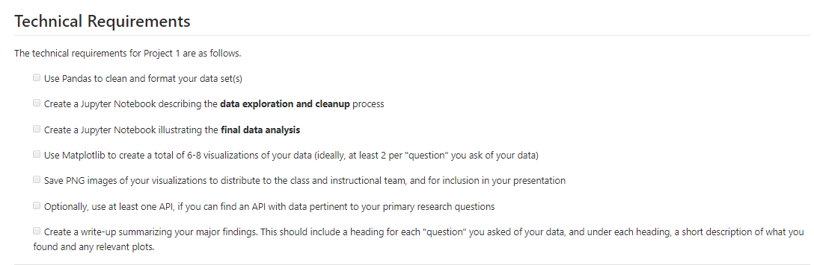
Technical requirements

Slide 5
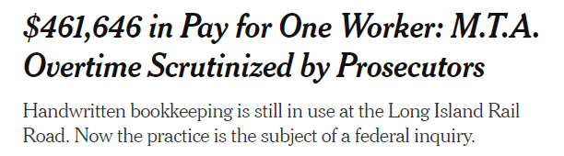
RESEARCH APPROACH
CONTEXT
A federal probe is currently looking to the MTA scandal with employees abusing over-time hours where one LIRR employee making $461,646 last year alone ($344,000 of which was from overtime, almost 3x their base salary!).
OBJECTIVES
Obtain insights into how much public New York City agencies are spending on base salaries and over-time salaries by using public budget by agency and city-wide salary data available on the NYC Open Data site to answer the following questions:
Which public agencies have the largest budgets?
Which public agencies spend the most on base salaries? on overtime?
Among the public agencies that spend the most on base salaries and on overtime, what percentage is each of the agency’s total budget?
Lastly, as a bonus, is there a salary difference across agencies for the same title?***

Slide 6
Data Cleanup & Exploration
Describe the exploration and cleanup process
Discuss insights you had while exploring the data that you didn't anticipate
Snapshots of data & how one of them had 3.3M rows of info
Source: VIP Crew CSR Study, June19, n=1,658
Notes:
Those >50YO are more likely to dislike rigid fabric and wide leg.

Slide 7
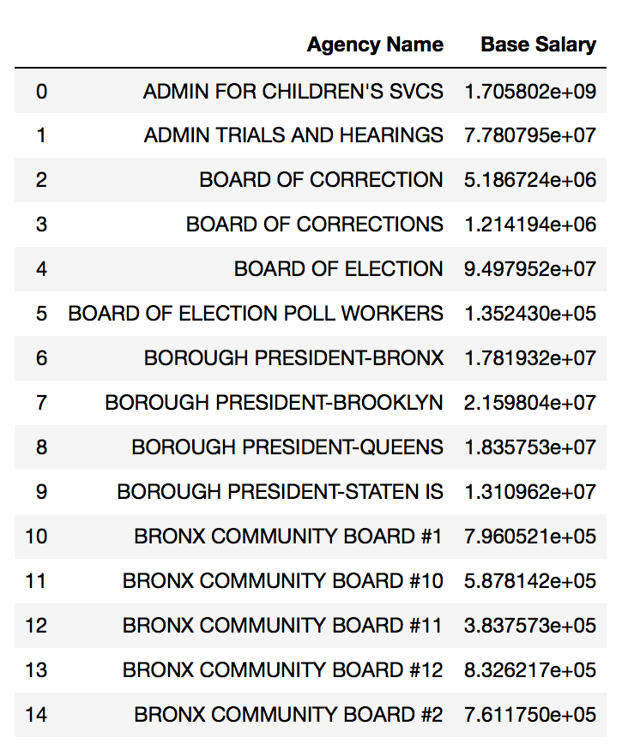
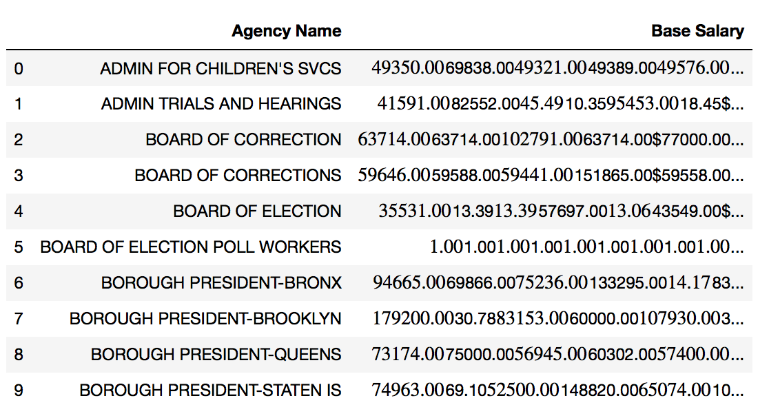
Data Cleanup & Exploration – steph
Describe the exploration and cleanup process
Discuss insights you had while exploring the data that you didn't anticipate
Source: VIP Crew CSR Study, June19, n=1,658
Notes:
Those >50YO are more likely to dislike rigid fabric and wide leg.

Slide 8
Data Cleanup & Exploration – limitations jenny
Describe the exploration and cleanup process
Discuss insights you had while exploring the data that you didn't anticipate
Source: VIP Crew CSR Study, June19, n=1,658
Notes:
Those >50YO are more likely to dislike rigid fabric and wide leg.

Slide 9
findings
Describe the exploration and cleanup process
Discuss insights you had while exploring the data that you didn't anticipate
PANDA TABLES
MATPLOTLIB TABLES
PANDA TABLES
MATPLOTLIB TABLES
Source: VIP Crew CSR Study, June19, n=1,658
Notes:
Those >50YO are more likely to dislike rigid fabric and wide leg.

Slide 10
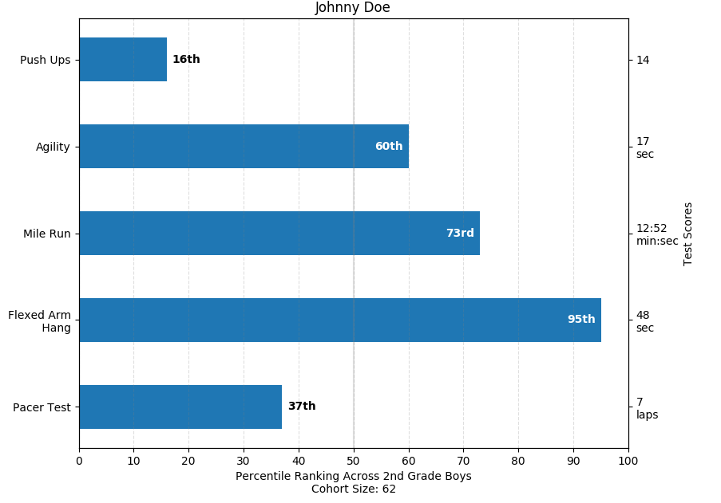
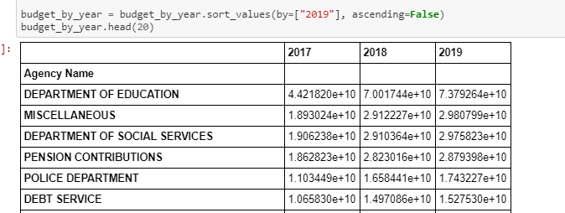
Findings jenny
Describe the exploration and cleanup process
Discuss insights you had while exploring the data that you didn't anticipate
Top agencies budget by 2017, 2018, 2019
Source: VIP Crew CSR Study, June19, n=1,658
Notes:
Those >50YO are more likely to dislike rigid fabric and wide leg.

Slide 11
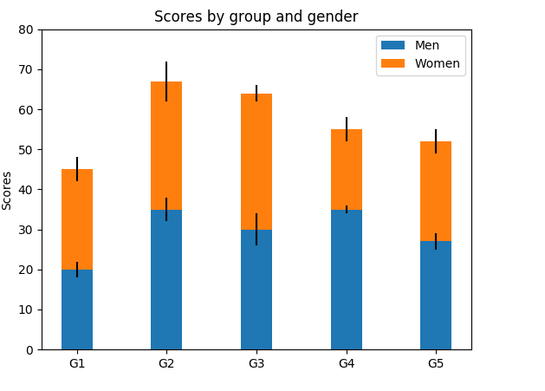
Findings Steph & Roaya
Top Total Salaries by Agency for 2016 with base salary & overtime salary color breakouts per agency
Top Base Salaries by Agency for 2016
Top Overtime Salaries by Agency for 2016
Source: VIP Crew CSR Study, June19, n=1,658
Notes:
Those >50YO are more likely to dislike rigid fabric and wide leg.

Slide 12
Findings Steph & Roaya
Top Number of Overtime Employees by Agency for 2016 AKA Which agencies have the largest % of overtime employees compared to their total overtime
THEORY FOR ROAYA: if a huge % of the total employees in an agency are using overtime, then that means the agency is not optimized and maybe should higher more employees to lower OT costs
Try to add t-testing here!
Source: VIP Crew CSR Study, June19, n=1,658
Notes:
Those >50YO are more likely to dislike rigid fabric and wide leg.

Slide 13
Findings Jatin
You’re putting slides 9 & 10 together: what is the % of total salary by total budget for the agencies we have in both files?
Source: VIP Crew CSR Study, June19, n=1,658
Notes:
Those >50YO are more likely to dislike rigid fabric and wide leg.

Slide 14
conclusions
EXECUTIVE SUMMARY
Source: VIP Crew CSR Study, June19, n=1,658
Notes:
Those >50YO are more likely to dislike rigid fabric and wide leg.

Slide 15
Post mortem – WOULD’VE, COULD’VE, SHOULD’VE
WOULD’VE
COULD’VE
SHOULD’VE

Slide 16
Questions?

Slide 17
Thank you!

